Slide 1
Advanced Programming
Unit 2: Programming languages

Slide 2
Introduction
We require an understanding of the features of programming languages which help you to make a choice of language for specific app development
Programming languages are often developed to suit one particular programming approach (model/paradigm) though may be able to be used in other ways
e.g. Java is essentially an Object Oriented language but has Functional support
A software developer will, typically, learn and develop with a number of programming languages so it is important to learn how to learn a new programming language
The TIOBE index measures usage of programming languages worldwide.

Slide 3
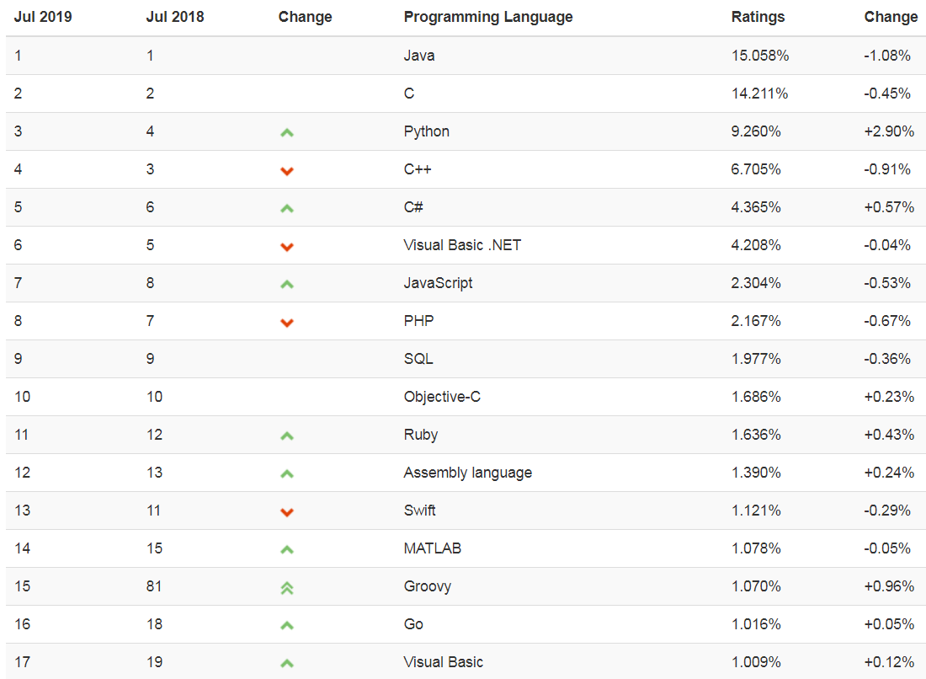
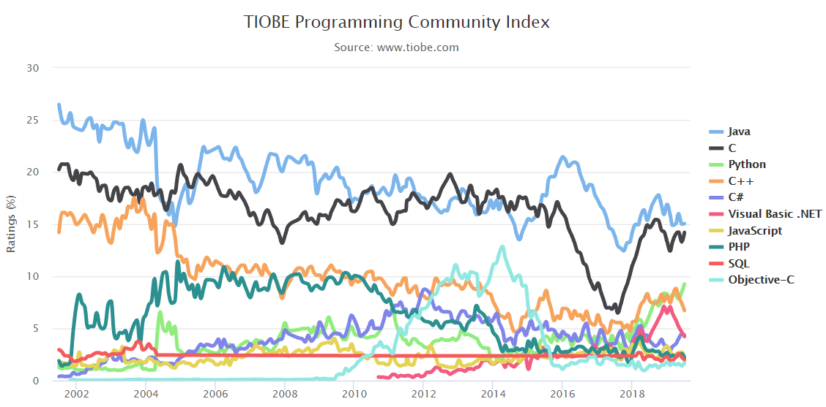
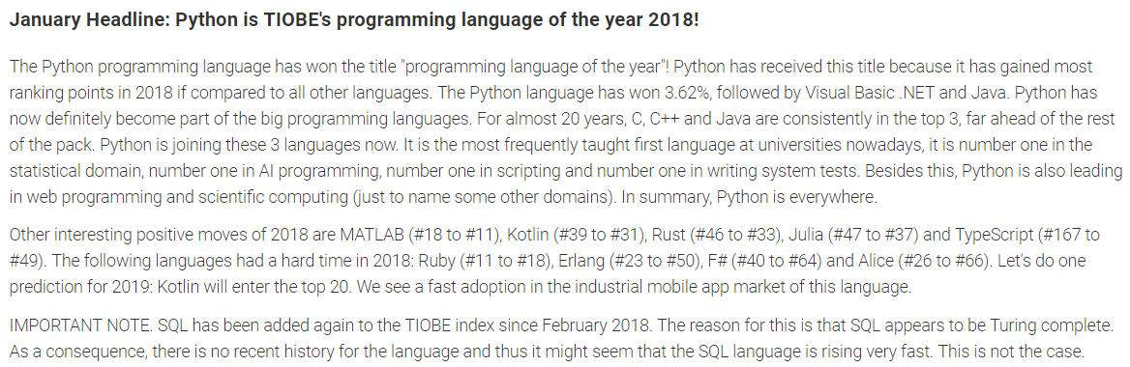
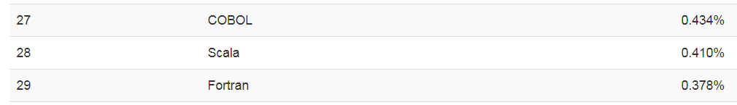
Popular Programming Languages

Slide 4
Why do we have different languages?
Different tools for different jobs
Different levels of support for different application types and domains, e.g. web, games, data analysis
Different trade-offs in performance, developer productivity, security, robustness, etc.
Different tools for different developers
A programming language is a tool for humans to express ideas to computers
Different programming paradigms express these ideas in very different ways
Many choices of good programming languages, can select one that “works the way I think”
People and communities
May choose to use what you know, or what your team knows
A good ecosystem (developer community and organisations) can make the individual developer more successful.

Slide 5
Why learn different languages?
Be in a position to choose the right tool for the job
“As I worked through the languages in this book, I often kicked myself, knowing that through the years, I’ve driven many a screw with a sledgehammer.” Bruce Tate, in Seven Languages in Seven Weeks
Learn how to learn new languages – you’ll have to do it sometime as a developer
“Learn at least one new language every year. Different languages solve the same problems in different ways. By learning several different approaches, you can help broaden your thinking and avoid getting stuck in a rut.” Andrew Hunt, David Thomas, in The Pragmatic Programmer
Become a better and more employable developer
Be more able to form your own opinions on the advantages and disadvantages of specific languages and the characteristics of those languages – developers tend to have strong opinions and rarely agree with each other!

Slide 6


What languages will you learn about?
Notice that the title says “learn about”, not “learn”
Will learn enough about a variety of languages to get a flavour of what makes them interesting
Will learn enough about a few languages to be able to do something useful with them:
Java (you know this one already)
Scala www.scala-lang.org
“Scala is an acronym for “Scalable Language”. This means that Scala grows with you. You can play with it by typing one-line expressions and observing the results. But you can also rely on it for large mission critical systems, as many companies, including Twitter, LinkedIn, or Intel do. At the root, the language’s scalability is the result of a careful integration of object-oriented and functional language concepts.”
Groovy http://www.groovy-lang.org
“Groovy is a powerful, optionally typed and dynamic language aimed at improving developer productivity thanks to a concise, familiar and easy to learn syntax.”

Slide 7
Classifying programming languages
Programming model, or paradigm
object oriented, functional, procedural, imperative, declarative, and so on
Typing model
static or dynamic
strong or weak
manifest or implicit
Language-specific idiosyncrasies
Execution model
compiled, interpreted, interactive mode, VM
Memory management
Decision constructs and core data structures
Core features that make the language unique

Slide 8
Typing Model
A number of typing models exist:
static or dynamic
strong or weak
manifest or implicit
language-specific idiosyncrasies
Let's consider the purpose of variables

Slide 9
Variables and typing
Most programming languages have the concept of variables
A variable is a storage location associated with a symbolic name, or identifier, that contains some piece of information, or value
A variable has a data type that specifies what kind of value it contains
Types classify values and also determine what operations are valid on a variable
Depending on the language, types can include various numeric types, characters, strings, booleans, and so on
In an object-oriented language, types can also include references to objects, and in a “pure” object-oriented language all types are represented as objects
Many (but not all) object-oriented languages allow new object types to be defined using classes

Slide 10
Static typing
Statically typed languages are those which define and enforce types at compile-time
For example, you could declare the following variables in some statically typed language:
int i = 5 string s = “4”
Each declaration specifies the type of the variable and assigns a value to it of the appropriate type, and the code compiles successfully
Any of the following would result in a compiler error, program cannot run until error fixed:
int j = i + s invalid operation i = “10” assigning invalid value to previously declared variable string t = 10 assigning invalid value when initialising variable
NOTE: this lecture is about general characteristics of programming languages. Except where noted explicitly, code samples/snippets are written in a non-specific “pseudo-language” which is used to illustrate these characteristics

Slide 11
Static typing (cont.)
You can think of a variable as being bound, at compile time, to a type through declaration
It can be bound to a value at compile time or at run time via an assignment statement, has a null value if not bound
Once a variable name has been bound to a type it can be bound only to values of a matching type; it cannot ever be bound to a value of a different type
name
value
type
IS OF TYPE…
type
must match

Slide 12
Manifest & Implicit Typing
Statically typed languages may have different ways in which the types of variables are identified at compile time
manifest typing is explicit identification by the programmer of the type of each variable being declared
For example if variable i is going to store integers then its type must be declared as integer
int i = 5
Some programming languages use implicit typing, or type inference, where the type is deduced from context at compile-time, for example the type to which the variable is bound may be determined by the compiler from the value to which it is bound
var i = 5
This can make code significantly more compact and readable when type names are long

Slide 13
Dynamic typing
In contrast, dynamic typing leaves type checks until runtime
Dynamic implies the possibility of changing as the program runs
Typically in a dynamic language you don’t have to declare variables, just assign values to an identifier:
i = 5 s = “4”
The following might (depending on the specific language) cause a run-time error
x = i + s
The same identifier can be reassigned to a different type of value, so the following would be valid
s = 3

Slide 14
Dynamic typing
Every variable name is (unless it is null) bound only to a value
Names are bound to objects at execution time by means of assignment statements
Possible to bind a name to objects of different types during the execution of the program.
name
value
IS OF TYPE…
type

Slide 15
Static vs Dynamic
Dynamically-typed languages are more flexible
can save development time and produce more compact source code
are useful for rapid prototyping and experimentation
have advantages in situations where program behaviour is truly dynamic, e.g, processing data sets where structure is not known a priori
However, lack of compile-time checking can lead to errors that are difficult to identify
for example assume that the intention here is to assign a value to number and then update its value using a calculation, but the developer misspells the variable name in the second line
number = 5 numbr = (number + 15) / 2
Static – assuming number previously declared, compiler will give error as numbr is undeclared
Dynamic – no error, will simply create new variable numbr, however, the value of number will not be updated as intended, which may lead to incorrect behaviour later

Slide 16
Strong typing
In a “type-safe” language, any attempt to misinterpret data is caught at compile time or generates a well-specified error at runtime
Strong typing is a mechanism that helps to enforce safety
A variable may be used only in ways that respect its type —for example, it is impossible to perform string operations on an int value
For example, the following would cause a compiler error or runtime error because there's no defined way to "add" strings and numbers to each other
i = 5 s = “4” x = i + s

Slide 17
Strong typing (cont.)
Strongly typed languages often have guarantees on runtime behaviour to ensure that no value can be interpreted as something that it is not
For example, if your program tries to access an array element:
myArray[i]
where i > the length of the array, then a runtime error or exception would be raised
Strongly typed languages can be either static or dynamic. Python is an example of a strongly typed dynamic language, while Scala is a strongly typed static language
Static/dynamic distinction refers to when type-checking is done
Strong/weak refers to what can be done with variables depending on their type

Slide 18
Weak typing
Weakly typed languages allow the type system to be subverted in some way – there are loopholes in the type system
For example some languages do implicit coercion of variable types so that they “just work” – change the type of a variable to suit the context in which it is used
i = 5 s = “4” x = i + s
With implicit coercion the type of one variable may be coerced so that they can be combined, giving a value for x of, for example, “54”
Note that in strongly-typed languages there may be some type conversion between certain related types where it is safe to do so, for example coercion of integer value to floating point value when combined in an expression, and explicit conversion by casting may be possible by casting or use of a type conversion function

Slide 19
Weak typing (cont.)
Another “weak” characteristic is the possibility of interpreting a variable as something that it is not, which can be “unsafe”
For example, C/C++ allow very direct access to memory through pointers, and allow pointer type casting without checking, also no array bounds checking – these can lead to unpredictable results when reading from memory and memory corruption when writing to memory, can cause crashes or security vulnerabilities
Definitions of strong and weak typing are not precise or widely agreed, best to think of these as general characteristics which may be found to a greater or lesser extent in a particular language
In general weak typing means that (to some extent) the programmer doesn’t need to worry about exactly what type each variable is, whereas with strong typing the programmer needs to make sure that a variable or value has an appropriate type for any operation that needs to be applied to it

Slide 20
Strong vs Weak typing
Weakly-typed languages are more flexible
can save development time and produce more compact source code (same comment as for dynamic but remember that weak and dynamic are not the same thing)
can pass any value as a parameter of a function (widely used in callback functions in JavaScript, for example)
can be very powerful in expert hands, e.g. optimisations through direct manipulation of memory in C
However, lack of type-safety can lead to unexpected or dangerous program behaviour

Slide 21
Summary
Static/dynamic, strong/weak are general terms that can’t be used to fully describe the behaviour of a specific language
Each language has its own type system, and these can differ in very obvious ways or in some much more subtle ways
Need to learn how the language you are using works – don’t make assumptions
For example, the key word var is used to declare variables in a number of languages
var i = 5
But, can have very different meaning in each, for example:
C# - this is static type inference, compiler will infer that i is an integer
JavaScript – variables are dynamic, can declare with or without var, affects variable scope, not type
Scala – a different meaning which you’ll see shortly

Slide 22
Execution Model
Some differences between languages lie in the process the programmer has to follow to create and execute statements and/or complete programmes
Some languages allow the programmer to write and execute code interactively at some kind of command prompt
Others require complete units of source code to be explicitly compiled before being executed
There are also differences in the way the program code is translated into something that will execute on the physical processor on the computer
Compiled vs. interpreted
Native code vs. virtual machine
These aspects of a programming language are independent of typing system and programming model

Slide 23
Compilation (native)
Compilation is the process of translating source code into something that is executable
Compilation process and tools are specific to a language and may be specific to a platform (OS/processor)
For example, gcc compiles C/C++ on the Linux platform
Process actually involves a number of steps and tools, each of which may create intermediate files other than the original source and final executable
Compiler translates source code to assembly language which expresses machine level instructions for specific platform
Compiler also checks syntax of source code, will not complete translation if errors found
Assembler turns this into Object code which includes data to allow unit of code to be linked with external code that it depends on
Linker combines object files and libraries into a single native executable program file (can then be executed directly by the OS/processor)
source code
assembly language
object code
executable code
compiler
assembler
linker
saved and executed later (run-time)

Slide 24
What does a compiler do?
Compilation involves several key stages/tools
Tokenizer (or lexer)
recognises “words”
divides input (source code) into individual tokens (strings with identified meaning) and passes these to parser
Parser
recognises structure
has knowledge of language syntax, identifies syntax errors and translates token stream into a data structure that represents the structure of the source code
data structure is called the parse tree, or asbstract syntax tree (AST)
Code generator
uses parse tree to generate code in the target language

Slide 25
Static and dynamic libraries
Linking static libraries
Includes the object file code from the library into the target executable binary
Results in a larger size on disk and slower launch times
Because the library's code is added directly to the linked target's binary, it means that to update any code in the library, the linked target would also have to be rebuilt
Linking dynamic libraries
None of the library's code is included directly into the linked target
Libraries are loaded into memory at runtime prior to having symbols (function call interfaces) getting resolved
Libraries can be updated with new features or bug-fixes without having to recompile and relink executable
Dynamic Link Libraries (DLLs) on Windows, shared libraries (.so) on Linux

Slide 26
Virtual machines
A virtual machine (VM) is a software-driven emulation of a given computer system.
There are many types of virtual machines, and they are classified by how precisely they are able to emulate or substitute for actual physical machines
System VM emulates a complete platform on which you can run an operating system, e.g. VMWare
Process VM is less fully-functional and can run one program or process, e.g. run a Windows executable on a Linux OS
Language VM is a kind of process VM which provides a layer of abstraction between compiled source code and a native platform
Compiler produces some intermediate language which is similar to assembly language but is not specific to a platform and is translated by the VM to native code at runtime
Compile once, run anywhere

Slide 27
Compilation (virtual machine)
Compilation for Java does not create native executable
Compiler creates bytecode (in .class files) which is not specific to any platform
Java Virtual Machine runs on top of OS, JVMs available for many platforms
Translates bytecode to native executable code at run time using Just-in-time (JIT) compiler
Extra work during runtime can affect performance, though modern JVMs can do optimisations
A number of other languages run on the JVM, code is compiled to bytecode (e.g. Scala, Groovy)
Some other modern “compiled” languages use similar VM-based model, e.g. .NET languages
source code
bytecode
bytecode
executable code
compiler
JIT compiler
saved to be loaded at run-time
program and library classes loaded into memory by JVM class loader when needed
executed immediately
JVM (run-time)

Slide 28
Interpreters
An interpreter directly executes instructions written in a programming or scripting language, without previously compiling them into a machine language program
No checking of syntax before run-time, execution stops at point where error encountered
Useful for interactive execution of code and rapid script development
Strategies:
parse the source code and perform its behaviour directly
translate (compile) source code into an intermediate representation and immediately execute this
Most modern “interpreted” languages (e.g. Python, Ruby, JavaScript, Groovy) use second strategy – compile to some kind of bytecode which is executed by a VM
Distinction between compilation/interpretation is blurred

Slide 29
Interpreters
Example – Python interpreter
Actually no such thing as an “interpreted language” or “compiled language” – there can be different implementations of the same language that use different strategies for execution
For example, while all current implementations of Python use the VM strategy, there are versions that use different VMs, e.g. JVM (Jython), .NET CLR (IronPython)
source code
bytecode
executable code
compiler
JIT compiler
library modules also loaded
executed immediately
VM
Python interpreter

Slide 30
Interacting with the language
Interactive language shell
commonly known as a read-eval-print loop (REPL)
evaluates each expression or statement as it is entered
displays output from any “print” statements
may also display results of expression evaluation
Scripting
script is created as a source code file containing statements
executed without the need to compile first
Language implementations for “interpreted” languages typically provide REPL and command line tools to run scripts
JavaScript is a special case in that scripts can also be embedded in web pages and executed by browser
Execution in either mode makes use of one of the interpreter strategies described earlier

Slide 31
Interacting with the language (cont.)
Languages such as Java, C, C# are considered to be “compiled” languages and the standard developer kits don’t include interactive tools such as REPLs
Note that the java command line tool is sometimes called the “java interpreter” but it invokes execution of code that has been previously compiled
Java doesn’t lend itself well to interactive execution of statements as syntax requires at least one class, with main method, to be defined
However there are implementations of REPLs for Java which behind the scenes need to “wrap” statements in a class for compilation and execution
CodePad in the BlueJ IDE is an example of this
Similar tools can be found for other compiled languages
Interaction modes are related to the tools available more than to the language itself

Slide 32
Memory management
Operating system memory management
Manage the resources of the memory structure of the computer and allocate memory to activities
The most significant part of this on many systems is virtual memory, which creates the illusion that every process has more memory than is actually available
OS memory management is also concerned with memory protection, security and protecting user programs from errors in other programs
Application memory management
Involves obtaining memory from the operating system, and managing its use by an application program
Application programs have dynamically changing storage requirements
Application must cope with this while minimizing the total CPU overhead, interactive pause times, and the total memory used

Slide 33
Application memory - stack and heap
The stack is the memory set aside as scratch space for a thread of execution
When a function is called, a block is reserved on the top of the stack for local variables
When that function returns, the block becomes unused and can be used the next time a function is called
The stack is always reserved in a LIFO (last in first out) order, simple to keep track of the stack and free memory
The heap is memory set aside for dynamic allocation
Unlike the stack, there's no enforced pattern to the allocation and deallocation of blocks from the heap;
Application can allocate a block at any time and free it at any time
This makes it much more complex to keep track of allocated/free memory
Local variables on the stack can contain references/pointers to items stored on the heap
Each thread gets a stack, while there's typically only one heap for the application/process

Slide 34
Application memory - stack and heap
the heap
the stack
String object
“Bob”
setName() dogName
Dog object
name
collar
go() dog
main() d
method local variables
Collar object
Note: this shows objects on the heap, but non-OO languages such as C also use heap memory

Slide 35
Manual memory management
In some systems or languages, it is up to the application program to manage all the details of allocating memory from the heap and freeing it when no longer required
Usually this is either by explicit calls to heap management functions (for example, malloc and free in C)
Languages that require manual manual memory management are known as unmanaged languages, e.g. C, C++
Advantages
Can be easier for the programmer to understand exactly what is going on
Can perform better when there is a shortage of memory
Disadvantages
the programmer must write a lot of code to do repetitive bookkeeping of memory
memory management bugs are common – can get memory leaks if memory is not freed even though its contents are never used again

Slide 36
Automatic memory management
Automatic memory management is a service that automatically recycles memory that a program would not otherwise use again
Automatic memory managers, often known as garbage collectors, usually do their job by recycling blocks that are unreachable the program variables
Languages that require manual manual memory management are known as managed languages, e.g. JVM langauges, .NET languages and most other modern languages
Advantages
Programmer is freed to work on the actual problem
Fewer memory management bugs
Memory management is often more efficient
Disadvantages
Memory may be retained because it is reachable, but won’t be used again
Programmer doesn’t have control over when garbage collection is done
Performance overhead

Slide 37
Recycling techniques
There are many ways for garbage collectors to determine what memory is no longer required, for example:
Tracing collectors determine which blocks of memory are reachable from the program variables
Most JVM implementations use mark-sweep collection, which works in two phases
Collector first examines the program variables, any blocks of memory pointed to are added to a list of blocks to be examined all blocks that can be reached by the program are marked.
In the second phase, the collector sweeps all allocated memory, searching for blocks that have not been marked. If it finds any, it returns them to the allocator for reuse, and unmarks all others – next time round any blocks previously allocated but no longer pointed to will then be unmarked.
Reference counting collectors keep a count of how many references (or pointers) there are to a particular memory block from other blocks
Count is incremented for each new reference, and is decremented if a reference is overwritten, or if the referring object is recycled.
If a reference count falls to zero, then the object is no longer required and can be recycled.

Slide 38
Finalizing
In garbage-collected languages, it is often necessary to perform finalization actions on some objects before their memory can be recycled
Common use of finalization is to release unmanaged resources such as file handles, database connections
For example, an open file might be represented by a stream object - when this object has been proven “dead” by the GC it is certain that the file is no longer in use by the program, and it can and should be closed before the stream is recycled
Examples - finalize method in Java, Finalize method in C#.
Note that there is no guarantee that finalization will in fact run and release the resource in a timely way
Should not rely on finalization – think of it as a “last-ditch” attempt to release the resource
Should always explicitly release resources in client code (e.g. code which opens and reads from a file) using exception handling (try-catch-finally, try-with-resources in Java, using/Dispose pattern in C#) to ensure this

Slide 39
Java finalize example
finalize in Java is a special method, rather like main method, which is called before the GC recycles the object.
Example of the finalize method in the Java API FileInputStream class
protected void finalize() throws IOException { if ((fd != null) && (fd != FileDescriptor.in)) { runningFinalize.set(Boolean.TRUE); try { close(); } finally { runningFinalize.set(Boolean.FALSE); } } }

Slide 40
Decision constructs and control structures
Most languages have the usual if, while and for statements with minor variations
A variety of other constructs exist, however, some specific to one language, some common to a number of languages, for example:
Pattern matching
a construct for choosing which variant of a function or expression is the correct one to apply
common in functional languages and fits in with their declarative nature
Comprehensions
allow procedures, typically involving transformations from one data structure than another, to be expressed in a declarative way rather than with traditional loops
common in but not exclusive to functional languages, e.g. also implemented in Python
for comprehensions in Scala much more powerful than usual for loop
You will learn more about these later with examples in Scala

Slide 41
Data structures
Data structures, or collections play a vital role in just about any language
Defined in the language or provided as libraries or modules
Some very well organised and integrated with the language, others less so (C#, for example)
Typically have arrays, lists, sets, tuples, dictionaries
Collections API defines what functions/methods can be called on a collection, functional languages usually have rich APIs supporting powerful filtering and transformation capabilities

Slide 42
Unique features
Some languages have features that make the language unique in some way or particularly useful in a certain type of scenario
Can be related to whole philosophy of the language, or simply features that are just useful and/or unusual
For example:
advanced features for concurrent or parallel programming (e.g. Scala, Erlang)
advanced features for statistics and data analysis (e.g. R)
source code indentation syntactically significant, enforcing readable code (Python)
close integration with JSON allowing easy data exchange (JavaScript)
checked exceptions to enforce exception handling (Java)

